Slide 1



NASA Operational Simulator for Small Satellites (NOS³)
NASA IV&V Independent Test Capability (ITC) Team
Mr. Scott Zemerick Scott.Zemerick@TMCTechnologies.com
Notes:
Diffused arches
(Intermediate)
To reproduce the shape effects on this slide, do the following:
On the Home tab, in the Slides group, click Layout, and then click Blank.
On the Home tab, in the Drawing group, click Shapes, and then under Lines, click Curve (tenth option from the left).
On the slide, click three points to draw a simple curved line, and then double-click to finish drawing.
Select the curved line. On the Home tab, in the Drawing group, click the arrow next to Shape Fill, point to Gradient, and then click More Gradients. In the Format Shape dialog box, click Fill in the left pane, select Gradient fill in the Fill pane, and then do the following:
In the Type list, select Linear.
Click the button next to Direction, and then click Linear Down (first row, second option from the left).
Under Gradient stops, click Add gradient stop or Remove gradient stop until two stops appear in the slider.
Also under Gradient stops, customize the gradient stops that you added as follows:
Select the first stop in the slider, and then do the following:
In the Position box, enter 0%.
Click the button next to Color, and then under Theme Colors click White, Background 1 (first row, first option from the left).
In the Transparency box, enter 50%.
Select the second stop in the slider, and then do the following:
In the Position box, enter 100%.
Click the button next to Color, and then under Theme Colors click White, Background 1 (first row, first option from the left).
In the Transparency box, enter 100%.
On the Home tab, in the Drawing group, click Shape Effects, point to Soft Edges, and then click 5 point.
On the Home tab, in the Drawing group, click the arrow next to Shape Outline, and then click No Outline.
To reproduce the background effects on this slide, do the following:
Right-click the slide background area, and then click Format Background. In the Format Background dialog box, click Fill in the left pane, select Gradient fill in the right pane, and then do the following:
In the Type list, select Radial.
Click the button next to Direction, and then click From Center (third option from the left).
Under Gradient stops, click Add gradient stop or Remove gradient stop until two stops appear in the slider
Also under Gradient stops, customize the gradient stops that you added as follows:
Select the first stop in the slider, and then do the following:
In the Position box, enter 0%.
Click the button next to Color, and then under Theme Colors click White, Background 1 (first row, first option from the left).
Select the second stop in the slider, and then do the following:
In the Position box, enter 100%.
Click the button next to Color, and then under Theme Colors click White, Background 1, Darker 50% (sixth row, first option from the left).
To reproduce the duplicate curved lines on the slide, do the following:
On the Home tab, in the Clipboard group, click the arrow under Copy, and then click Duplicate. Repeat the process for a total of three curved lines.
On the slide, drag the curved lines to position them as needed.
Right-click one of the duplicate curved lines, click Edit Points, and then drag the points on the curve to make a new shape. Repeat the process with the other duplicate curved line.

Slide 2

Agenda
STF-1 Intro
NASA IV&V CubeSat
C&DH FSW Architecture
NOS³
V1.0
Architecture
Conclusion
Next Steps
Questions
Simulators
ITC Intro
Notes:
Diffused arches
(Intermediate)
To reproduce the shape effects on this slide, do the following:
On the Home tab, in the Slides group, click Layout, and then click Blank.
On the Home tab, in the Drawing group, click Shapes, and then under Lines, click Curve (tenth option from the left).
On the slide, click three points to draw a simple curved line, and then double-click to finish drawing.
Select the curved line. On the Home tab, in the Drawing group, click the arrow next to Shape Fill, point to Gradient, and then click More Gradients. In the Format Shape dialog box, click Fill in the left pane, select Gradient fill in the Fill pane, and then do the following:
In the Type list, select Linear.
Click the button next to Direction, and then click Linear Down (first row, second option from the left).
Under Gradient stops, click Add gradient stop or Remove gradient stop until two stops appear in the slider.
Also under Gradient stops, customize the gradient stops that you added as follows:
Select the first stop in the slider, and then do the following:
In the Position box, enter 0%.
Click the button next to Color, and then under Theme Colors click White, Background 1 (first row, first option from the left).
In the Transparency box, enter 50%.
Select the second stop in the slider, and then do the following:
In the Position box, enter 100%.
Click the button next to Color, and then under Theme Colors click White, Background 1 (first row, first option from the left).
In the Transparency box, enter 100%.
On the Home tab, in the Drawing group, click Shape Effects, point to Soft Edges, and then click 5 point.
On the Home tab, in the Drawing group, click the arrow next to Shape Outline, and then click No Outline.
To reproduce the background effects on this slide, do the following:
Right-click the slide background area, and then click Format Background. In the Format Background dialog box, click Fill in the left pane, select Gradient fill in the right pane, and then do the following:
In the Type list, select Radial.
Click the button next to Direction, and then click From Center (third option from the left).
Under Gradient stops, click Add gradient stop or Remove gradient stop until two stops appear in the slider
Also under Gradient stops, customize the gradient stops that you added as follows:
Select the first stop in the slider, and then do the following:
In the Position box, enter 0%.
Click the button next to Color, and then under Theme Colors click White, Background 1 (first row, first option from the left).
Select the second stop in the slider, and then do the following:
In the Position box, enter 100%.
Click the button next to Color, and then under Theme Colors click White, Background 1, Darker 50% (sixth row, first option from the left).
To reproduce the duplicate curved lines on the slide, do the following:
On the Home tab, in the Clipboard group, click the arrow under Copy, and then click Duplicate. Repeat the process for a total of three curved lines.
On the slide, drag the curved lines to position them as needed.
Right-click one of the duplicate curved lines, click Edit Points, and then drag the points on the curve to make a new shape. Repeat the process with the other duplicate curved line.

Slide 3

Independent Test Capability (ITC) Introduction
Notes:
Diffused arches
(Intermediate)
To reproduce the shape effects on this slide, do the following:
On the Home tab, in the Slides group, click Layout, and then click Blank.
On the Home tab, in the Drawing group, click Shapes, and then under Lines, click Curve (tenth option from the left).
On the slide, click three points to draw a simple curved line, and then double-click to finish drawing.
Select the curved line. On the Home tab, in the Drawing group, click the arrow next to Shape Fill, point to Gradient, and then click More Gradients. In the Format Shape dialog box, click Fill in the left pane, select Gradient fill in the Fill pane, and then do the following:
In the Type list, select Linear.
Click the button next to Direction, and then click Linear Down (first row, second option from the left).
Under Gradient stops, click Add gradient stop or Remove gradient stop until two stops appear in the slider.
Also under Gradient stops, customize the gradient stops that you added as follows:
Select the first stop in the slider, and then do the following:
In the Position box, enter 0%.
Click the button next to Color, and then under Theme Colors click White, Background 1 (first row, first option from the left).
In the Transparency box, enter 50%.
Select the second stop in the slider, and then do the following:
In the Position box, enter 100%.
Click the button next to Color, and then under Theme Colors click White, Background 1 (first row, first option from the left).
In the Transparency box, enter 100%.
On the Home tab, in the Drawing group, click Shape Effects, point to Soft Edges, and then click 5 point.
On the Home tab, in the Drawing group, click the arrow next to Shape Outline, and then click No Outline.
To reproduce the background effects on this slide, do the following:
Right-click the slide background area, and then click Format Background. In the Format Background dialog box, click Fill in the left pane, select Gradient fill in the right pane, and then do the following:
In the Type list, select Radial.
Click the button next to Direction, and then click From Center (third option from the left).
Under Gradient stops, click Add gradient stop or Remove gradient stop until two stops appear in the slider
Also under Gradient stops, customize the gradient stops that you added as follows:
Select the first stop in the slider, and then do the following:
In the Position box, enter 0%.
Click the button next to Color, and then under Theme Colors click White, Background 1 (first row, first option from the left).
Select the second stop in the slider, and then do the following:
In the Position box, enter 100%.
Click the button next to Color, and then under Theme Colors click White, Background 1, Darker 50% (sixth row, first option from the left).
To reproduce the duplicate curved lines on the slide, do the following:
On the Home tab, in the Clipboard group, click the arrow under Copy, and then click Duplicate. Repeat the process for a total of three curved lines.
On the slide, drag the curved lines to position them as needed.
Right-click one of the duplicate curved lines, click Edit Points, and then drag the points on the curve to make a new shape. Repeat the process with the other duplicate curved line.

Slide 4

NASA IV&V Independent Test Capability (ITC)
Charter
Acquire, develop, and manage adaptable test environments that enable the dynamic analysis of software behaviors for multiple NASA missions
Dynamic Analysis is performed on flight software to verify software behavior
Notes:
Diffused arches
(Intermediate)
To reproduce the shape effects on this slide, do the following:
On the Home tab, in the Slides group, click Layout, and then click Blank.
On the Home tab, in the Drawing group, click Shapes, and then under Lines, click Curve (tenth option from the left).
On the slide, click three points to draw a simple curved line, and then double-click to finish drawing.
Select the curved line. On the Home tab, in the Drawing group, click the arrow next to Shape Fill, point to Gradient, and then click More Gradients. In the Format Shape dialog box, click Fill in the left pane, select Gradient fill in the Fill pane, and then do the following:
In the Type list, select Linear.
Click the button next to Direction, and then click Linear Down (first row, second option from the left).
Under Gradient stops, click Add gradient stop or Remove gradient stop until two stops appear in the slider.
Also under Gradient stops, customize the gradient stops that you added as follows:
Select the first stop in the slider, and then do the following:
In the Position box, enter 0%.
Click the button next to Color, and then under Theme Colors click White, Background 1 (first row, first option from the left).
In the Transparency box, enter 50%.
Select the second stop in the slider, and then do the following:
In the Position box, enter 100%.
Click the button next to Color, and then under Theme Colors click White, Background 1 (first row, first option from the left).
In the Transparency box, enter 100%.
On the Home tab, in the Drawing group, click Shape Effects, point to Soft Edges, and then click 5 point.
On the Home tab, in the Drawing group, click the arrow next to Shape Outline, and then click No Outline.
To reproduce the background effects on this slide, do the following:
Right-click the slide background area, and then click Format Background. In the Format Background dialog box, click Fill in the left pane, select Gradient fill in the right pane, and then do the following:
In the Type list, select Radial.
Click the button next to Direction, and then click From Center (third option from the left).
Under Gradient stops, click Add gradient stop or Remove gradient stop until two stops appear in the slider
Also under Gradient stops, customize the gradient stops that you added as follows:
Select the first stop in the slider, and then do the following:
In the Position box, enter 0%.
Click the button next to Color, and then under Theme Colors click White, Background 1 (first row, first option from the left).
Select the second stop in the slider, and then do the following:
In the Position box, enter 100%.
Click the button next to Color, and then under Theme Colors click White, Background 1, Darker 50% (sixth row, first option from the left).
To reproduce the duplicate curved lines on the slide, do the following:
On the Home tab, in the Clipboard group, click the arrow under Copy, and then click Duplicate. Repeat the process for a total of three curved lines.
On the slide, drag the curved lines to position them as needed.
Right-click one of the duplicate curved lines, click Edit Points, and then drag the points on the curve to make a new shape. Repeat the process with the other duplicate curved line.

Slide 5
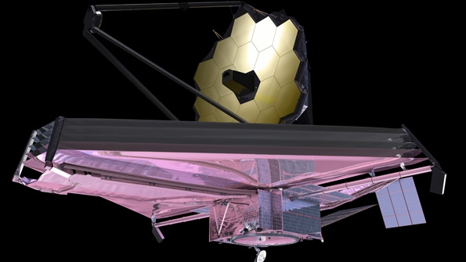

NASA IV&V Independent Test Capability (ITC)
JIST
S3
JWST Integrated Simulation & Test
SLS Software-Only-Simulator
Automation and virtual deployment
QEMU RAD750 Model
Wind River Simics Modeling
Small Sats
Notes:
Diffused arches
(Intermediate)
To reproduce the shape effects on this slide, do the following:
On the Home tab, in the Slides group, click Layout, and then click Blank.
On the Home tab, in the Drawing group, click Shapes, and then under Lines, click Curve (tenth option from the left).
On the slide, click three points to draw a simple curved line, and then double-click to finish drawing.
Select the curved line. On the Home tab, in the Drawing group, click the arrow next to Shape Fill, point to Gradient, and then click More Gradients. In the Format Shape dialog box, click Fill in the left pane, select Gradient fill in the Fill pane, and then do the following:
In the Type list, select Linear.
Click the button next to Direction, and then click Linear Down (first row, second option from the left).
Under Gradient stops, click Add gradient stop or Remove gradient stop until two stops appear in the slider.
Also under Gradient stops, customize the gradient stops that you added as follows:
Select the first stop in the slider, and then do the following:
In the Position box, enter 0%.
Click the button next to Color, and then under Theme Colors click White, Background 1 (first row, first option from the left).
In the Transparency box, enter 50%.
Select the second stop in the slider, and then do the following:
In the Position box, enter 100%.
Click the button next to Color, and then under Theme Colors click White, Background 1 (first row, first option from the left).
In the Transparency box, enter 100%.
On the Home tab, in the Drawing group, click Shape Effects, point to Soft Edges, and then click 5 point.
On the Home tab, in the Drawing group, click the arrow next to Shape Outline, and then click No Outline.
To reproduce the background effects on this slide, do the following:
Right-click the slide background area, and then click Format Background. In the Format Background dialog box, click Fill in the left pane, select Gradient fill in the right pane, and then do the following:
In the Type list, select Radial.
Click the button next to Direction, and then click From Center (third option from the left).
Under Gradient stops, click Add gradient stop or Remove gradient stop until two stops appear in the slider
Also under Gradient stops, customize the gradient stops that you added as follows:
Select the first stop in the slider, and then do the following:
In the Position box, enter 0%.
Click the button next to Color, and then under Theme Colors click White, Background 1 (first row, first option from the left).
Select the second stop in the slider, and then do the following:
In the Position box, enter 100%.
Click the button next to Color, and then under Theme Colors click White, Background 1, Darker 50% (sixth row, first option from the left).
To reproduce the duplicate curved lines on the slide, do the following:
On the Home tab, in the Clipboard group, click the arrow under Copy, and then click Duplicate. Repeat the process for a total of three curved lines.
On the slide, drag the curved lines to position them as needed.
Right-click one of the duplicate curved lines, click Edit Points, and then drag the points on the curve to make a new shape. Repeat the process with the other duplicate curved line.

Slide 6
Simulation-to-Flight (STF-1)
Introduction
Notes:
Diffused arches
(Intermediate)
To reproduce the shape effects on this slide, do the following:
On the Home tab, in the Slides group, click Layout, and then click Blank.
On the Home tab, in the Drawing group, click Shapes, and then under Lines, click Curve (tenth option from the left).
On the slide, click three points to draw a simple curved line, and then double-click to finish drawing.
Select the curved line. On the Home tab, in the Drawing group, click the arrow next to Shape Fill, point to Gradient, and then click More Gradients. In the Format Shape dialog box, click Fill in the left pane, select Gradient fill in the Fill pane, and then do the following:
In the Type list, select Linear.
Click the button next to Direction, and then click Linear Down (first row, second option from the left).
Under Gradient stops, click Add gradient stop or Remove gradient stop until two stops appear in the slider.
Also under Gradient stops, customize the gradient stops that you added as follows:
Select the first stop in the slider, and then do the following:
In the Position box, enter 0%.
Click the button next to Color, and then under Theme Colors click White, Background 1 (first row, first option from the left).
In the Transparency box, enter 50%.
Select the second stop in the slider, and then do the following:
In the Position box, enter 100%.
Click the button next to Color, and then under Theme Colors click White, Background 1 (first row, first option from the left).
In the Transparency box, enter 100%.
On the Home tab, in the Drawing group, click Shape Effects, point to Soft Edges, and then click 5 point.
On the Home tab, in the Drawing group, click the arrow next to Shape Outline, and then click No Outline.
To reproduce the background effects on this slide, do the following:
Right-click the slide background area, and then click Format Background. In the Format Background dialog box, click Fill in the left pane, select Gradient fill in the right pane, and then do the following:
In the Type list, select Radial.
Click the button next to Direction, and then click From Center (third option from the left).
Under Gradient stops, click Add gradient stop or Remove gradient stop until two stops appear in the slider
Also under Gradient stops, customize the gradient stops that you added as follows:
Select the first stop in the slider, and then do the following:
In the Position box, enter 0%.
Click the button next to Color, and then under Theme Colors click White, Background 1 (first row, first option from the left).
Select the second stop in the slider, and then do the following:
In the Position box, enter 100%.
Click the button next to Color, and then under Theme Colors click White, Background 1, Darker 50% (sixth row, first option from the left).
To reproduce the duplicate curved lines on the slide, do the following:
On the Home tab, in the Clipboard group, click the arrow under Copy, and then click Duplicate. Repeat the process for a total of three curved lines.
On the slide, drag the curved lines to position them as needed.
Right-click one of the duplicate curved lines, click Edit Points, and then drag the points on the curve to make a new shape. Repeat the process with the other duplicate curved line.

Slide 7


Simulation-to-Flight (STF-1)
NASA IV&V ITC & West Virginia University (WVU) 3U Cubesat
ITC is responsible for C&DH hardware/software, integration (hw/sw), and all testing
Simulation-to-Flight (STF-1)
Primary Objective – Showcase simulation technologies developed at IV&V
WVU is responsible for payload hardware and software
NASA Cubesat Launch Initiative (CLI) proposal submitted and accepted – NASA will pay manifest for future launch
First WV Cubesat
Secondary Objectives – WVU Research into space weather, rad-hard materials, navigation instruments (GPS and IMUs), and camera
STF-1 is a “GSFC Cubesat” – partnering with GSFC/WFF and Dellingr Cubesat Team
Current Launch Ready Date is August 2016 – not yet manifested – prefer polar orbit
Notes:
Diffused arches
(Intermediate)
To reproduce the shape effects on this slide, do the following:
On the Home tab, in the Slides group, click Layout, and then click Blank.
On the Home tab, in the Drawing group, click Shapes, and then under Lines, click Curve (tenth option from the left).
On the slide, click three points to draw a simple curved line, and then double-click to finish drawing.
Select the curved line. On the Home tab, in the Drawing group, click the arrow next to Shape Fill, point to Gradient, and then click More Gradients. In the Format Shape dialog box, click Fill in the left pane, select Gradient fill in the Fill pane, and then do the following:
In the Type list, select Linear.
Click the button next to Direction, and then click Linear Down (first row, second option from the left).
Under Gradient stops, click Add gradient stop or Remove gradient stop until two stops appear in the slider.
Also under Gradient stops, customize the gradient stops that you added as follows:
Select the first stop in the slider, and then do the following:
In the Position box, enter 0%.
Click the button next to Color, and then under Theme Colors click White, Background 1 (first row, first option from the left).
In the Transparency box, enter 50%.
Select the second stop in the slider, and then do the following:
In the Position box, enter 100%.
Click the button next to Color, and then under Theme Colors click White, Background 1 (first row, first option from the left).
In the Transparency box, enter 100%.
On the Home tab, in the Drawing group, click Shape Effects, point to Soft Edges, and then click 5 point.
On the Home tab, in the Drawing group, click the arrow next to Shape Outline, and then click No Outline.
To reproduce the background effects on this slide, do the following:
Right-click the slide background area, and then click Format Background. In the Format Background dialog box, click Fill in the left pane, select Gradient fill in the right pane, and then do the following:
In the Type list, select Radial.
Click the button next to Direction, and then click From Center (third option from the left).
Under Gradient stops, click Add gradient stop or Remove gradient stop until two stops appear in the slider
Also under Gradient stops, customize the gradient stops that you added as follows:
Select the first stop in the slider, and then do the following:
In the Position box, enter 0%.
Click the button next to Color, and then under Theme Colors click White, Background 1 (first row, first option from the left).
Select the second stop in the slider, and then do the following:
In the Position box, enter 100%.
Click the button next to Color, and then under Theme Colors click White, Background 1, Darker 50% (sixth row, first option from the left).
To reproduce the duplicate curved lines on the slide, do the following:
On the Home tab, in the Clipboard group, click the arrow under Copy, and then click Duplicate. Repeat the process for a total of three curved lines.
On the slide, drag the curved lines to position them as needed.
Right-click one of the duplicate curved lines, click Edit Points, and then drag the points on the curve to make a new shape. Repeat the process with the other duplicate curved line.

Slide 8
Simulation-to-Flight (STF-1)
STF-1 Flight Software / Hardware Design
Dellingr reuse, specifically on the radio cFS application
FSW is Core Flight System (cFS)
ITC designed solar panel PCBs (Dellingr-based)
Most hardware same as other GSFC cubesats
Working closely with the GSFC Dellingr 6U cubesat team
Hardware | Status
Onboard Computer | Received
Solar Cells | Received
Power System | Ordered – 10 Week Lead Time
Chassis | Ordered – Unknown Lead Time
ITC Designed Solar Panel PCBs | Designed – Out for Quote
Radio | Ordered – 6 Month Lead Time
Clean Room | Procured and Setup for Ribbon Cutting
Deployable Antenna | Ordered – Unknown Lead Time
Camera | Received
Notes:
Diffused arches
(Intermediate)
To reproduce the shape effects on this slide, do the following:
On the Home tab, in the Slides group, click Layout, and then click Blank.
On the Home tab, in the Drawing group, click Shapes, and then under Lines, click Curve (tenth option from the left).
On the slide, click three points to draw a simple curved line, and then double-click to finish drawing.
Select the curved line. On the Home tab, in the Drawing group, click the arrow next to Shape Fill, point to Gradient, and then click More Gradients. In the Format Shape dialog box, click Fill in the left pane, select Gradient fill in the Fill pane, and then do the following:
In the Type list, select Linear.
Click the button next to Direction, and then click Linear Down (first row, second option from the left).
Under Gradient stops, click Add gradient stop or Remove gradient stop until two stops appear in the slider.
Also under Gradient stops, customize the gradient stops that you added as follows:
Select the first stop in the slider, and then do the following:
In the Position box, enter 0%.
Click the button next to Color, and then under Theme Colors click White, Background 1 (first row, first option from the left).
In the Transparency box, enter 50%.
Select the second stop in the slider, and then do the following:
In the Position box, enter 100%.
Click the button next to Color, and then under Theme Colors click White, Background 1 (first row, first option from the left).
In the Transparency box, enter 100%.
On the Home tab, in the Drawing group, click Shape Effects, point to Soft Edges, and then click 5 point.
On the Home tab, in the Drawing group, click the arrow next to Shape Outline, and then click No Outline.
To reproduce the background effects on this slide, do the following:
Right-click the slide background area, and then click Format Background. In the Format Background dialog box, click Fill in the left pane, select Gradient fill in the right pane, and then do the following:
In the Type list, select Radial.
Click the button next to Direction, and then click From Center (third option from the left).
Under Gradient stops, click Add gradient stop or Remove gradient stop until two stops appear in the slider
Also under Gradient stops, customize the gradient stops that you added as follows:
Select the first stop in the slider, and then do the following:
In the Position box, enter 0%.
Click the button next to Color, and then under Theme Colors click White, Background 1 (first row, first option from the left).
Select the second stop in the slider, and then do the following:
In the Position box, enter 100%.
Click the button next to Color, and then under Theme Colors click White, Background 1, Darker 50% (sixth row, first option from the left).
To reproduce the duplicate curved lines on the slide, do the following:
On the Home tab, in the Clipboard group, click the arrow under Copy, and then click Duplicate. Repeat the process for a total of three curved lines.
On the slide, drag the curved lines to position them as needed.
Right-click one of the duplicate curved lines, click Edit Points, and then drag the points on the curve to make a new shape. Repeat the process with the other duplicate curved line.

Slide 9

Notes:
Diffused arches
(Intermediate)
To reproduce the shape effects on this slide, do the following:
On the Home tab, in the Slides group, click Layout, and then click Blank.
On the Home tab, in the Drawing group, click Shapes, and then under Lines, click Curve (tenth option from the left).
On the slide, click three points to draw a simple curved line, and then double-click to finish drawing.
Select the curved line. On the Home tab, in the Drawing group, click the arrow next to Shape Fill, point to Gradient, and then click More Gradients. In the Format Shape dialog box, click Fill in the left pane, select Gradient fill in the Fill pane, and then do the following:
In the Type list, select Linear.
Click the button next to Direction, and then click Linear Down (first row, second option from the left).
Under Gradient stops, click Add gradient stop or Remove gradient stop until two stops appear in the slider.
Also under Gradient stops, customize the gradient stops that you added as follows:
Select the first stop in the slider, and then do the following:
In the Position box, enter 0%.
Click the button next to Color, and then under Theme Colors click White, Background 1 (first row, first option from the left).
In the Transparency box, enter 50%.
Select the second stop in the slider, and then do the following:
In the Position box, enter 100%.
Click the button next to Color, and then under Theme Colors click White, Background 1 (first row, first option from the left).
In the Transparency box, enter 100%.
On the Home tab, in the Drawing group, click Shape Effects, point to Soft Edges, and then click 5 point.
On the Home tab, in the Drawing group, click the arrow next to Shape Outline, and then click No Outline.
To reproduce the background effects on this slide, do the following:
Right-click the slide background area, and then click Format Background. In the Format Background dialog box, click Fill in the left pane, select Gradient fill in the right pane, and then do the following:
In the Type list, select Radial.
Click the button next to Direction, and then click From Center (third option from the left).
Under Gradient stops, click Add gradient stop or Remove gradient stop until two stops appear in the slider
Also under Gradient stops, customize the gradient stops that you added as follows:
Select the first stop in the slider, and then do the following:
In the Position box, enter 0%.
Click the button next to Color, and then under Theme Colors click White, Background 1 (first row, first option from the left).
Select the second stop in the slider, and then do the following:
In the Position box, enter 100%.
Click the button next to Color, and then under Theme Colors click White, Background 1, Darker 50% (sixth row, first option from the left).
To reproduce the duplicate curved lines on the slide, do the following:
On the Home tab, in the Clipboard group, click the arrow under Copy, and then click Duplicate. Repeat the process for a total of three curved lines.
On the slide, drag the curved lines to position them as needed.
Right-click one of the duplicate curved lines, click Edit Points, and then drag the points on the curve to make a new shape. Repeat the process with the other duplicate curved line.

Slide 10

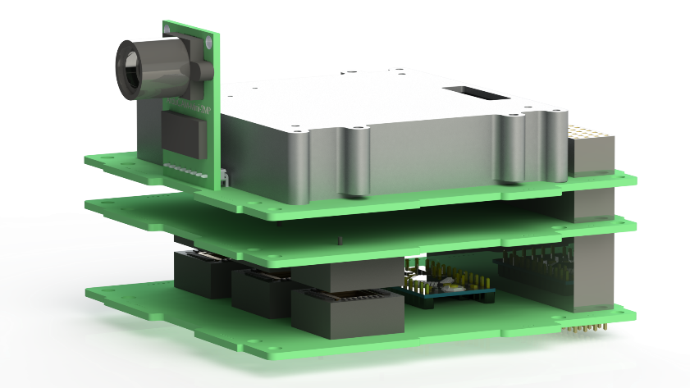
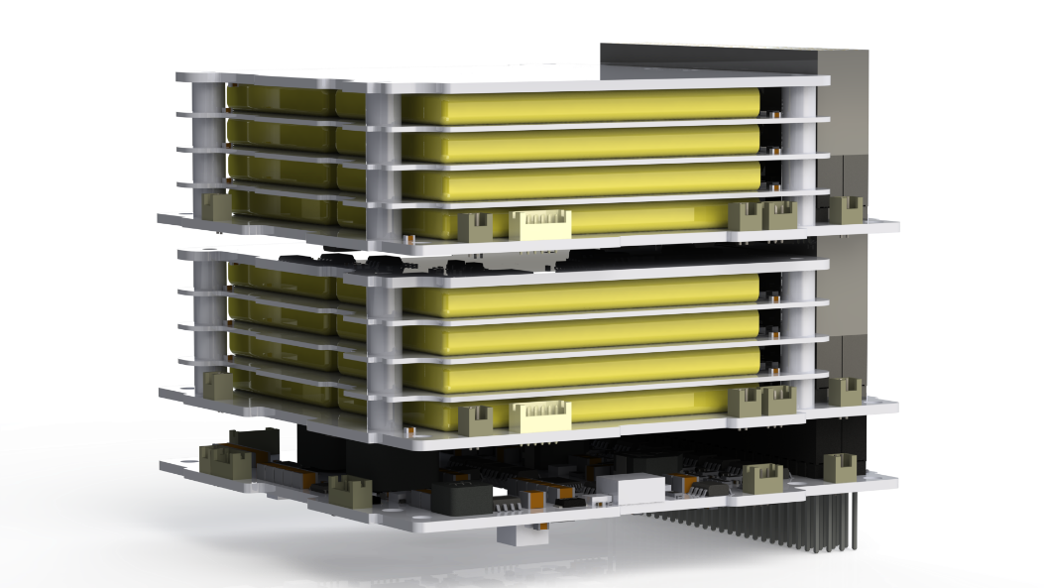
Simulation-to-Flight (STF-1)
Notes:
Diffused arches
(Intermediate)
To reproduce the shape effects on this slide, do the following:
On the Home tab, in the Slides group, click Layout, and then click Blank.
On the Home tab, in the Drawing group, click Shapes, and then under Lines, click Curve (tenth option from the left).
On the slide, click three points to draw a simple curved line, and then double-click to finish drawing.
Select the curved line. On the Home tab, in the Drawing group, click the arrow next to Shape Fill, point to Gradient, and then click More Gradients. In the Format Shape dialog box, click Fill in the left pane, select Gradient fill in the Fill pane, and then do the following:
In the Type list, select Linear.
Click the button next to Direction, and then click Linear Down (first row, second option from the left).
Under Gradient stops, click Add gradient stop or Remove gradient stop until two stops appear in the slider.
Also under Gradient stops, customize the gradient stops that you added as follows:
Select the first stop in the slider, and then do the following:
In the Position box, enter 0%.
Click the button next to Color, and then under Theme Colors click White, Background 1 (first row, first option from the left).
In the Transparency box, enter 50%.
Select the second stop in the slider, and then do the following:
In the Position box, enter 100%.
Click the button next to Color, and then under Theme Colors click White, Background 1 (first row, first option from the left).
In the Transparency box, enter 100%.
On the Home tab, in the Drawing group, click Shape Effects, point to Soft Edges, and then click 5 point.
On the Home tab, in the Drawing group, click the arrow next to Shape Outline, and then click No Outline.
To reproduce the background effects on this slide, do the following:
Right-click the slide background area, and then click Format Background. In the Format Background dialog box, click Fill in the left pane, select Gradient fill in the right pane, and then do the following:
In the Type list, select Radial.
Click the button next to Direction, and then click From Center (third option from the left).
Under Gradient stops, click Add gradient stop or Remove gradient stop until two stops appear in the slider
Also under Gradient stops, customize the gradient stops that you added as follows:
Select the first stop in the slider, and then do the following:
In the Position box, enter 0%.
Click the button next to Color, and then under Theme Colors click White, Background 1 (first row, first option from the left).
Select the second stop in the slider, and then do the following:
In the Position box, enter 100%.
Click the button next to Color, and then under Theme Colors click White, Background 1, Darker 50% (sixth row, first option from the left).
To reproduce the duplicate curved lines on the slide, do the following:
On the Home tab, in the Clipboard group, click the arrow under Copy, and then click Duplicate. Repeat the process for a total of three curved lines.
On the slide, drag the curved lines to position them as needed.
Right-click one of the duplicate curved lines, click Edit Points, and then drag the points on the curve to make a new shape. Repeat the process with the other duplicate curved line.

Slide 11
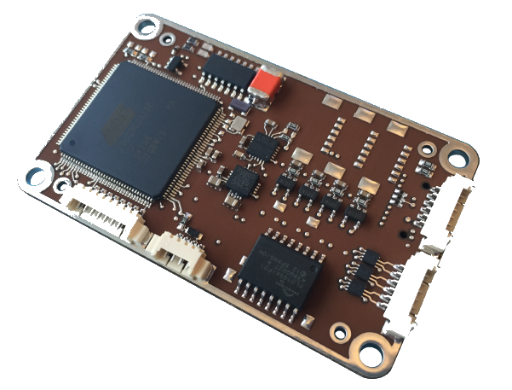
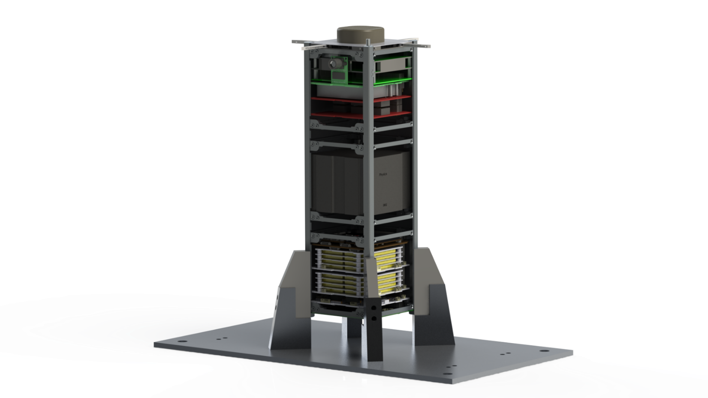

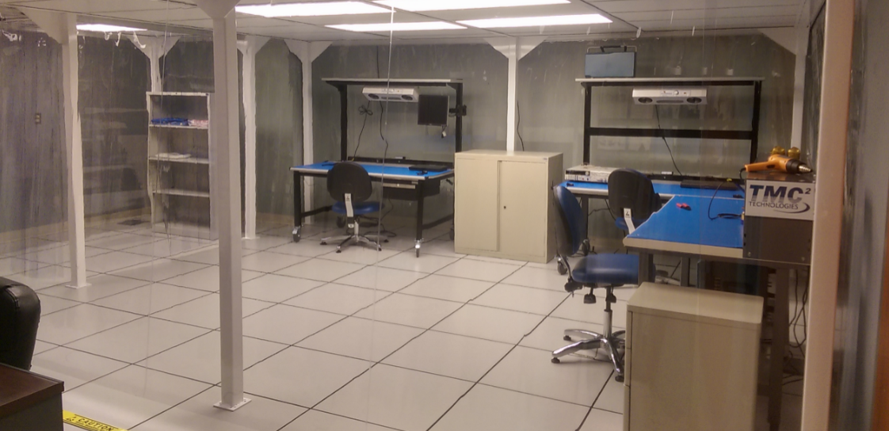
Simulation-to-Flight (STF-1)
Notes:
Diffused arches
(Intermediate)
To reproduce the shape effects on this slide, do the following:
On the Home tab, in the Slides group, click Layout, and then click Blank.
On the Home tab, in the Drawing group, click Shapes, and then under Lines, click Curve (tenth option from the left).
On the slide, click three points to draw a simple curved line, and then double-click to finish drawing.
Select the curved line. On the Home tab, in the Drawing group, click the arrow next to Shape Fill, point to Gradient, and then click More Gradients. In the Format Shape dialog box, click Fill in the left pane, select Gradient fill in the Fill pane, and then do the following:
In the Type list, select Linear.
Click the button next to Direction, and then click Linear Down (first row, second option from the left).
Under Gradient stops, click Add gradient stop or Remove gradient stop until two stops appear in the slider.
Also under Gradient stops, customize the gradient stops that you added as follows:
Select the first stop in the slider, and then do the following:
In the Position box, enter 0%.
Click the button next to Color, and then under Theme Colors click White, Background 1 (first row, first option from the left).
In the Transparency box, enter 50%.
Select the second stop in the slider, and then do the following:
In the Position box, enter 100%.
Click the button next to Color, and then under Theme Colors click White, Background 1 (first row, first option from the left).
In the Transparency box, enter 100%.
On the Home tab, in the Drawing group, click Shape Effects, point to Soft Edges, and then click 5 point.
On the Home tab, in the Drawing group, click the arrow next to Shape Outline, and then click No Outline.
To reproduce the background effects on this slide, do the following:
Right-click the slide background area, and then click Format Background. In the Format Background dialog box, click Fill in the left pane, select Gradient fill in the right pane, and then do the following:
In the Type list, select Radial.
Click the button next to Direction, and then click From Center (third option from the left).
Under Gradient stops, click Add gradient stop or Remove gradient stop until two stops appear in the slider
Also under Gradient stops, customize the gradient stops that you added as follows:
Select the first stop in the slider, and then do the following:
In the Position box, enter 0%.
Click the button next to Color, and then under Theme Colors click White, Background 1 (first row, first option from the left).
Select the second stop in the slider, and then do the following:
In the Position box, enter 100%.
Click the button next to Color, and then under Theme Colors click White, Background 1, Darker 50% (sixth row, first option from the left).
To reproduce the duplicate curved lines on the slide, do the following:
On the Home tab, in the Clipboard group, click the arrow under Copy, and then click Duplicate. Repeat the process for a total of three curved lines.
On the slide, drag the curved lines to position them as needed.
Right-click one of the duplicate curved lines, click Edit Points, and then drag the points on the curve to make a new shape. Repeat the process with the other duplicate curved line.

Slide 12
Simulation-to-Flight (STF-1)
STF-1
FSW
Architecture
cFS
OS Abstraction Layer (OSAL)
FreeRTOS
Flight
Hardware
Notes:
Diffused arches
(Intermediate)
To reproduce the shape effects on this slide, do the following:
On the Home tab, in the Slides group, click Layout, and then click Blank.
On the Home tab, in the Drawing group, click Shapes, and then under Lines, click Curve (tenth option from the left).
On the slide, click three points to draw a simple curved line, and then double-click to finish drawing.
Select the curved line. On the Home tab, in the Drawing group, click the arrow next to Shape Fill, point to Gradient, and then click More Gradients. In the Format Shape dialog box, click Fill in the left pane, select Gradient fill in the Fill pane, and then do the following:
In the Type list, select Linear.
Click the button next to Direction, and then click Linear Down (first row, second option from the left).
Under Gradient stops, click Add gradient stop or Remove gradient stop until two stops appear in the slider.
Also under Gradient stops, customize the gradient stops that you added as follows:
Select the first stop in the slider, and then do the following:
In the Position box, enter 0%.
Click the button next to Color, and then under Theme Colors click White, Background 1 (first row, first option from the left).
In the Transparency box, enter 50%.
Select the second stop in the slider, and then do the following:
In the Position box, enter 100%.
Click the button next to Color, and then under Theme Colors click White, Background 1 (first row, first option from the left).
In the Transparency box, enter 100%.
On the Home tab, in the Drawing group, click Shape Effects, point to Soft Edges, and then click 5 point.
On the Home tab, in the Drawing group, click the arrow next to Shape Outline, and then click No Outline.
To reproduce the background effects on this slide, do the following:
Right-click the slide background area, and then click Format Background. In the Format Background dialog box, click Fill in the left pane, select Gradient fill in the right pane, and then do the following:
In the Type list, select Radial.
Click the button next to Direction, and then click From Center (third option from the left).
Under Gradient stops, click Add gradient stop or Remove gradient stop until two stops appear in the slider
Also under Gradient stops, customize the gradient stops that you added as follows:
Select the first stop in the slider, and then do the following:
In the Position box, enter 0%.
Click the button next to Color, and then under Theme Colors click White, Background 1 (first row, first option from the left).
Select the second stop in the slider, and then do the following:
In the Position box, enter 100%.
Click the button next to Color, and then under Theme Colors click White, Background 1, Darker 50% (sixth row, first option from the left).
To reproduce the duplicate curved lines on the slide, do the following:
On the Home tab, in the Clipboard group, click the arrow under Copy, and then click Duplicate. Repeat the process for a total of three curved lines.
On the slide, drag the curved lines to position them as needed.
Right-click one of the duplicate curved lines, click Edit Points, and then drag the points on the curve to make a new shape. Repeat the process with the other duplicate curved line.

Slide 13
NASA Operational Simulator for Small Satellites (NOS³) Introduction
Notes:
Diffused arches
(Intermediate)
To reproduce the shape effects on this slide, do the following:
On the Home tab, in the Slides group, click Layout, and then click Blank.
On the Home tab, in the Drawing group, click Shapes, and then under Lines, click Curve (tenth option from the left).
On the slide, click three points to draw a simple curved line, and then double-click to finish drawing.
Select the curved line. On the Home tab, in the Drawing group, click the arrow next to Shape Fill, point to Gradient, and then click More Gradients. In the Format Shape dialog box, click Fill in the left pane, select Gradient fill in the Fill pane, and then do the following:
In the Type list, select Linear.
Click the button next to Direction, and then click Linear Down (first row, second option from the left).
Under Gradient stops, click Add gradient stop or Remove gradient stop until two stops appear in the slider.
Also under Gradient stops, customize the gradient stops that you added as follows:
Select the first stop in the slider, and then do the following:
In the Position box, enter 0%.
Click the button next to Color, and then under Theme Colors click White, Background 1 (first row, first option from the left).
In the Transparency box, enter 50%.
Select the second stop in the slider, and then do the following:
In the Position box, enter 100%.
Click the button next to Color, and then under Theme Colors click White, Background 1 (first row, first option from the left).
In the Transparency box, enter 100%.
On the Home tab, in the Drawing group, click Shape Effects, point to Soft Edges, and then click 5 point.
On the Home tab, in the Drawing group, click the arrow next to Shape Outline, and then click No Outline.
To reproduce the background effects on this slide, do the following:
Right-click the slide background area, and then click Format Background. In the Format Background dialog box, click Fill in the left pane, select Gradient fill in the right pane, and then do the following:
In the Type list, select Radial.
Click the button next to Direction, and then click From Center (third option from the left).
Under Gradient stops, click Add gradient stop or Remove gradient stop until two stops appear in the slider
Also under Gradient stops, customize the gradient stops that you added as follows:
Select the first stop in the slider, and then do the following:
In the Position box, enter 0%.
Click the button next to Color, and then under Theme Colors click White, Background 1 (first row, first option from the left).
Select the second stop in the slider, and then do the following:
In the Position box, enter 100%.
Click the button next to Color, and then under Theme Colors click White, Background 1, Darker 50% (sixth row, first option from the left).
To reproduce the duplicate curved lines on the slide, do the following:
On the Home tab, in the Clipboard group, click the arrow under Copy, and then click Duplicate. Repeat the process for a total of three curved lines.
On the slide, drag the curved lines to position them as needed.
Right-click one of the duplicate curved lines, click Edit Points, and then drag the points on the curve to make a new shape. Repeat the process with the other duplicate curved line.

Slide 14
NOS³
What is NOS³?
What is it used for?
FSW early-development – NOS³ provides real-world inputs to FSW
A software test bed for small satellites
Easily-interfaces to cFS FSW, but cFS not required
Based upon STF-1 hardware, but sufficiently generic
FSW V&V – Testing FSW, invalid inputs, behavior, stress conditions
FSW Integration – Used for early-app development and payload team integration
Mission Planning – Example: power analysis
Currently open-loop, closed loop planned
Openly distributed solution Ready-to-Run (RTR) – Looking for Users!
A collection of Linux executable and libraries
Notes:
Diffused arches
(Intermediate)
To reproduce the shape effects on this slide, do the following:
On the Home tab, in the Slides group, click Layout, and then click Blank.
On the Home tab, in the Drawing group, click Shapes, and then under Lines, click Curve (tenth option from the left).
On the slide, click three points to draw a simple curved line, and then double-click to finish drawing.
Select the curved line. On the Home tab, in the Drawing group, click the arrow next to Shape Fill, point to Gradient, and then click More Gradients. In the Format Shape dialog box, click Fill in the left pane, select Gradient fill in the Fill pane, and then do the following:
In the Type list, select Linear.
Click the button next to Direction, and then click Linear Down (first row, second option from the left).
Under Gradient stops, click Add gradient stop or Remove gradient stop until two stops appear in the slider.
Also under Gradient stops, customize the gradient stops that you added as follows:
Select the first stop in the slider, and then do the following:
In the Position box, enter 0%.
Click the button next to Color, and then under Theme Colors click White, Background 1 (first row, first option from the left).
In the Transparency box, enter 50%.
Select the second stop in the slider, and then do the following:
In the Position box, enter 100%.
Click the button next to Color, and then under Theme Colors click White, Background 1 (first row, first option from the left).
In the Transparency box, enter 100%.
On the Home tab, in the Drawing group, click Shape Effects, point to Soft Edges, and then click 5 point.
On the Home tab, in the Drawing group, click the arrow next to Shape Outline, and then click No Outline.
To reproduce the background effects on this slide, do the following:
Right-click the slide background area, and then click Format Background. In the Format Background dialog box, click Fill in the left pane, select Gradient fill in the right pane, and then do the following:
In the Type list, select Radial.
Click the button next to Direction, and then click From Center (third option from the left).
Under Gradient stops, click Add gradient stop or Remove gradient stop until two stops appear in the slider
Also under Gradient stops, customize the gradient stops that you added as follows:
Select the first stop in the slider, and then do the following:
In the Position box, enter 0%.
Click the button next to Color, and then under Theme Colors click White, Background 1 (first row, first option from the left).
Select the second stop in the slider, and then do the following:
In the Position box, enter 100%.
Click the button next to Color, and then under Theme Colors click White, Background 1, Darker 50% (sixth row, first option from the left).
To reproduce the duplicate curved lines on the slide, do the following:
On the Home tab, in the Clipboard group, click the arrow under Copy, and then click Duplicate. Repeat the process for a total of three curved lines.
On the slide, drag the curved lines to position them as needed.
Right-click one of the duplicate curved lines, click Edit Points, and then drag the points on the curve to make a new shape. Repeat the process with the other duplicate curved line.

Slide 15
NOS³ Ready-to-Run (RTR)
Leverage ITC virtual deployment technologies
Deployment Steps
Ready-to-Run (RTR) for…
cFS development environment
NOS³ environment
ITC does NOT distribute virtual machines
Virtual machines are built on-the-fly by the user
Obtain files ITC
Install virtual machine provisioner such as Virtual Box
Run 1 Command – generates virtual machine
Login to virtual machine and build cFS with RTR script
Ground system software
Software integration testing
Notes:
Diffused arches
(Intermediate)
To reproduce the shape effects on this slide, do the following:
On the Home tab, in the Slides group, click Layout, and then click Blank.
On the Home tab, in the Drawing group, click Shapes, and then under Lines, click Curve (tenth option from the left).
On the slide, click three points to draw a simple curved line, and then double-click to finish drawing.
Select the curved line. On the Home tab, in the Drawing group, click the arrow next to Shape Fill, point to Gradient, and then click More Gradients. In the Format Shape dialog box, click Fill in the left pane, select Gradient fill in the Fill pane, and then do the following:
In the Type list, select Linear.
Click the button next to Direction, and then click Linear Down (first row, second option from the left).
Under Gradient stops, click Add gradient stop or Remove gradient stop until two stops appear in the slider.
Also under Gradient stops, customize the gradient stops that you added as follows:
Select the first stop in the slider, and then do the following:
In the Position box, enter 0%.
Click the button next to Color, and then under Theme Colors click White, Background 1 (first row, first option from the left).
In the Transparency box, enter 50%.
Select the second stop in the slider, and then do the following:
In the Position box, enter 100%.
Click the button next to Color, and then under Theme Colors click White, Background 1 (first row, first option from the left).
In the Transparency box, enter 100%.
On the Home tab, in the Drawing group, click Shape Effects, point to Soft Edges, and then click 5 point.
On the Home tab, in the Drawing group, click the arrow next to Shape Outline, and then click No Outline.
To reproduce the background effects on this slide, do the following:
Right-click the slide background area, and then click Format Background. In the Format Background dialog box, click Fill in the left pane, select Gradient fill in the right pane, and then do the following:
In the Type list, select Radial.
Click the button next to Direction, and then click From Center (third option from the left).
Under Gradient stops, click Add gradient stop or Remove gradient stop until two stops appear in the slider
Also under Gradient stops, customize the gradient stops that you added as follows:
Select the first stop in the slider, and then do the following:
In the Position box, enter 0%.
Click the button next to Color, and then under Theme Colors click White, Background 1 (first row, first option from the left).
Select the second stop in the slider, and then do the following:
In the Position box, enter 100%.
Click the button next to Color, and then under Theme Colors click White, Background 1, Darker 50% (sixth row, first option from the left).
To reproduce the duplicate curved lines on the slide, do the following:
On the Home tab, in the Clipboard group, click the arrow under Copy, and then click Duplicate. Repeat the process for a total of three curved lines.
On the slide, drag the curved lines to position them as needed.
Right-click one of the duplicate curved lines, click Edit Points, and then drag the points on the curve to make a new shape. Repeat the process with the other duplicate curved line.

Slide 16
NOS³
Linux Software Architecture
Sim
cFS
FSW
NOS
Engine
Process
Process
Process
Sim
Process
Notes:
Diffused arches
(Intermediate)
To reproduce the shape effects on this slide, do the following:
On the Home tab, in the Slides group, click Layout, and then click Blank.
On the Home tab, in the Drawing group, click Shapes, and then under Lines, click Curve (tenth option from the left).
On the slide, click three points to draw a simple curved line, and then double-click to finish drawing.
Select the curved line. On the Home tab, in the Drawing group, click the arrow next to Shape Fill, point to Gradient, and then click More Gradients. In the Format Shape dialog box, click Fill in the left pane, select Gradient fill in the Fill pane, and then do the following:
In the Type list, select Linear.
Click the button next to Direction, and then click Linear Down (first row, second option from the left).
Under Gradient stops, click Add gradient stop or Remove gradient stop until two stops appear in the slider.
Also under Gradient stops, customize the gradient stops that you added as follows:
Select the first stop in the slider, and then do the following:
In the Position box, enter 0%.
Click the button next to Color, and then under Theme Colors click White, Background 1 (first row, first option from the left).
In the Transparency box, enter 50%.
Select the second stop in the slider, and then do the following:
In the Position box, enter 100%.
Click the button next to Color, and then under Theme Colors click White, Background 1 (first row, first option from the left).
In the Transparency box, enter 100%.
On the Home tab, in the Drawing group, click Shape Effects, point to Soft Edges, and then click 5 point.
On the Home tab, in the Drawing group, click the arrow next to Shape Outline, and then click No Outline.
To reproduce the background effects on this slide, do the following:
Right-click the slide background area, and then click Format Background. In the Format Background dialog box, click Fill in the left pane, select Gradient fill in the right pane, and then do the following:
In the Type list, select Radial.
Click the button next to Direction, and then click From Center (third option from the left).
Under Gradient stops, click Add gradient stop or Remove gradient stop until two stops appear in the slider
Also under Gradient stops, customize the gradient stops that you added as follows:
Select the first stop in the slider, and then do the following:
In the Position box, enter 0%.
Click the button next to Color, and then under Theme Colors click White, Background 1 (first row, first option from the left).
Select the second stop in the slider, and then do the following:
In the Position box, enter 100%.
Click the button next to Color, and then under Theme Colors click White, Background 1, Darker 50% (sixth row, first option from the left).
To reproduce the duplicate curved lines on the slide, do the following:
On the Home tab, in the Clipboard group, click the arrow under Copy, and then click Duplicate. Repeat the process for a total of three curved lines.
On the slide, drag the curved lines to position them as needed.
Right-click one of the duplicate curved lines, click Edit Points, and then drag the points on the curve to make a new shape. Repeat the process with the other duplicate curved line.

Slide 17


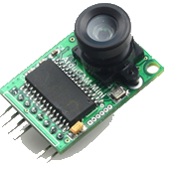
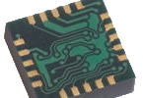
NOS³
NOS³ v1 Included Simulators
Simulator | Hardware Modeled | Sim Usage
Magnetometer | Honeywell HMC5843 | FSW data source for development
Electrical Power System (EPS) | Clydespace Gen III | Power analysis – software control of switches
GPS | Novatel | FSW data source for development and software commanding of GPS
Camera | ArduCam Mini OV2640 SPI/I2C | FSW data source for development and large data packet handling
Notes:
Diffused arches
(Intermediate)
To reproduce the shape effects on this slide, do the following:
On the Home tab, in the Slides group, click Layout, and then click Blank.
On the Home tab, in the Drawing group, click Shapes, and then under Lines, click Curve (tenth option from the left).
On the slide, click three points to draw a simple curved line, and then double-click to finish drawing.
Select the curved line. On the Home tab, in the Drawing group, click the arrow next to Shape Fill, point to Gradient, and then click More Gradients. In the Format Shape dialog box, click Fill in the left pane, select Gradient fill in the Fill pane, and then do the following:
In the Type list, select Linear.
Click the button next to Direction, and then click Linear Down (first row, second option from the left).
Under Gradient stops, click Add gradient stop or Remove gradient stop until two stops appear in the slider.
Also under Gradient stops, customize the gradient stops that you added as follows:
Select the first stop in the slider, and then do the following:
In the Position box, enter 0%.
Click the button next to Color, and then under Theme Colors click White, Background 1 (first row, first option from the left).
In the Transparency box, enter 50%.
Select the second stop in the slider, and then do the following:
In the Position box, enter 100%.
Click the button next to Color, and then under Theme Colors click White, Background 1 (first row, first option from the left).
In the Transparency box, enter 100%.
On the Home tab, in the Drawing group, click Shape Effects, point to Soft Edges, and then click 5 point.
On the Home tab, in the Drawing group, click the arrow next to Shape Outline, and then click No Outline.
To reproduce the background effects on this slide, do the following:
Right-click the slide background area, and then click Format Background. In the Format Background dialog box, click Fill in the left pane, select Gradient fill in the right pane, and then do the following:
In the Type list, select Radial.
Click the button next to Direction, and then click From Center (third option from the left).
Under Gradient stops, click Add gradient stop or Remove gradient stop until two stops appear in the slider
Also under Gradient stops, customize the gradient stops that you added as follows:
Select the first stop in the slider, and then do the following:
In the Position box, enter 0%.
Click the button next to Color, and then under Theme Colors click White, Background 1 (first row, first option from the left).
Select the second stop in the slider, and then do the following:
In the Position box, enter 100%.
Click the button next to Color, and then under Theme Colors click White, Background 1, Darker 50% (sixth row, first option from the left).
To reproduce the duplicate curved lines on the slide, do the following:
On the Home tab, in the Clipboard group, click the arrow under Copy, and then click Duplicate. Repeat the process for a total of three curved lines.
On the slide, drag the curved lines to position them as needed.
Right-click one of the duplicate curved lines, click Edit Points, and then drag the points on the curve to make a new shape. Repeat the process with the other duplicate curved line.

Slide 18
NOS³ Components
Component | What is it? | How is it used?
NASA Operational Simulator (NOS) Engine | Engine is ITC-developed message passing middleware designed specifically for use in simulation. Includes time synchronization, data manipulation, and fault injection. | Serves as the NOS³ glue to tie all components together into a common interface to FSW
Hardware Model | A model for a specific piece of flight hardware, often focusing on the inputs/outputs of the device from the FSW perspective. | Serves as virtual hardware in order to provide FSW with an accurate representation of its data
42 | 42 is an open-source general purpose simulator developed at NASA Goddard Space Flight Center for spacecraft attitude and orbit dynamics. | Serves as an Environment Data Provider – chosen to provide magnetic field data and positional data as inputs to the magnetometer and GPS simulators
NOS Engine
Message
NOS Engine Interface
time, input bytes
Hardware
Model
Environment
Data
Provider
NOS Engine
Message
output bytes
environmental
data
time
Notes:
Diffused arches
(Intermediate)
To reproduce the shape effects on this slide, do the following:
On the Home tab, in the Slides group, click Layout, and then click Blank.
On the Home tab, in the Drawing group, click Shapes, and then under Lines, click Curve (tenth option from the left).
On the slide, click three points to draw a simple curved line, and then double-click to finish drawing.
Select the curved line. On the Home tab, in the Drawing group, click the arrow next to Shape Fill, point to Gradient, and then click More Gradients. In the Format Shape dialog box, click Fill in the left pane, select Gradient fill in the Fill pane, and then do the following:
In the Type list, select Linear.
Click the button next to Direction, and then click Linear Down (first row, second option from the left).
Under Gradient stops, click Add gradient stop or Remove gradient stop until two stops appear in the slider.
Also under Gradient stops, customize the gradient stops that you added as follows:
Select the first stop in the slider, and then do the following:
In the Position box, enter 0%.
Click the button next to Color, and then under Theme Colors click White, Background 1 (first row, first option from the left).
In the Transparency box, enter 50%.
Select the second stop in the slider, and then do the following:
In the Position box, enter 100%.
Click the button next to Color, and then under Theme Colors click White, Background 1 (first row, first option from the left).
In the Transparency box, enter 100%.
On the Home tab, in the Drawing group, click Shape Effects, point to Soft Edges, and then click 5 point.
On the Home tab, in the Drawing group, click the arrow next to Shape Outline, and then click No Outline.
To reproduce the background effects on this slide, do the following:
Right-click the slide background area, and then click Format Background. In the Format Background dialog box, click Fill in the left pane, select Gradient fill in the right pane, and then do the following:
In the Type list, select Radial.
Click the button next to Direction, and then click From Center (third option from the left).
Under Gradient stops, click Add gradient stop or Remove gradient stop until two stops appear in the slider
Also under Gradient stops, customize the gradient stops that you added as follows:
Select the first stop in the slider, and then do the following:
In the Position box, enter 0%.
Click the button next to Color, and then under Theme Colors click White, Background 1 (first row, first option from the left).
Select the second stop in the slider, and then do the following:
In the Position box, enter 100%.
Click the button next to Color, and then under Theme Colors click White, Background 1, Darker 50% (sixth row, first option from the left).
To reproduce the duplicate curved lines on the slide, do the following:
On the Home tab, in the Clipboard group, click the arrow under Copy, and then click Duplicate. Repeat the process for a total of three curved lines.
On the slide, drag the curved lines to position them as needed.
Right-click one of the duplicate curved lines, click Edit Points, and then drag the points on the curve to make a new shape. Repeat the process with the other duplicate curved line.

Slide 19

NOS³ Components
NOS Engine
Message
NOS Engine Interface
time, input bytes
Hardware
Model
Environment
Data
Provider
NOS Engine
Message
output bytes
environmental
data
NOS Engine
Message
NOS Engine Interface
time, input bytes
Hardware
Model
FSW
output bytes
NOS Engine
Message
output bytes
environmental
data
NOS Engine
Message
NOS Engine Interface
time, input bytes
Hardware
Model
NOS Engine
Message
output bytes
environmental
data
time
Notes:
Diffused arches
(Intermediate)
To reproduce the shape effects on this slide, do the following:
On the Home tab, in the Slides group, click Layout, and then click Blank.
On the Home tab, in the Drawing group, click Shapes, and then under Lines, click Curve (tenth option from the left).
On the slide, click three points to draw a simple curved line, and then double-click to finish drawing.
Select the curved line. On the Home tab, in the Drawing group, click the arrow next to Shape Fill, point to Gradient, and then click More Gradients. In the Format Shape dialog box, click Fill in the left pane, select Gradient fill in the Fill pane, and then do the following:
In the Type list, select Linear.
Click the button next to Direction, and then click Linear Down (first row, second option from the left).
Under Gradient stops, click Add gradient stop or Remove gradient stop until two stops appear in the slider.
Also under Gradient stops, customize the gradient stops that you added as follows:
Select the first stop in the slider, and then do the following:
In the Position box, enter 0%.
Click the button next to Color, and then under Theme Colors click White, Background 1 (first row, first option from the left).
In the Transparency box, enter 50%.
Select the second stop in the slider, and then do the following:
In the Position box, enter 100%.
Click the button next to Color, and then under Theme Colors click White, Background 1 (first row, first option from the left).
In the Transparency box, enter 100%.
On the Home tab, in the Drawing group, click Shape Effects, point to Soft Edges, and then click 5 point.
On the Home tab, in the Drawing group, click the arrow next to Shape Outline, and then click No Outline.
To reproduce the background effects on this slide, do the following:
Right-click the slide background area, and then click Format Background. In the Format Background dialog box, click Fill in the left pane, select Gradient fill in the right pane, and then do the following:
In the Type list, select Radial.
Click the button next to Direction, and then click From Center (third option from the left).
Under Gradient stops, click Add gradient stop or Remove gradient stop until two stops appear in the slider
Also under Gradient stops, customize the gradient stops that you added as follows:
Select the first stop in the slider, and then do the following:
In the Position box, enter 0%.
Click the button next to Color, and then under Theme Colors click White, Background 1 (first row, first option from the left).
Select the second stop in the slider, and then do the following:
In the Position box, enter 100%.
Click the button next to Color, and then under Theme Colors click White, Background 1, Darker 50% (sixth row, first option from the left).
To reproduce the duplicate curved lines on the slide, do the following:
On the Home tab, in the Clipboard group, click the arrow under Copy, and then click Duplicate. Repeat the process for a total of three curved lines.
On the slide, drag the curved lines to position them as needed.
Right-click one of the duplicate curved lines, click Edit Points, and then drag the points on the curve to make a new shape. Repeat the process with the other duplicate curved line.

Slide 20

STF-1 FSW + NOS³
STF-1
cFS
No FSW code
changes
OS Abstraction Layer (OSAL)
Linux
FreeRTOS
NOS³
Flight
Hardware
Notes:
Diffused arches
(Intermediate)
To reproduce the shape effects on this slide, do the following:
On the Home tab, in the Slides group, click Layout, and then click Blank.
On the Home tab, in the Drawing group, click Shapes, and then under Lines, click Curve (tenth option from the left).
On the slide, click three points to draw a simple curved line, and then double-click to finish drawing.
Select the curved line. On the Home tab, in the Drawing group, click the arrow next to Shape Fill, point to Gradient, and then click More Gradients. In the Format Shape dialog box, click Fill in the left pane, select Gradient fill in the Fill pane, and then do the following:
In the Type list, select Linear.
Click the button next to Direction, and then click Linear Down (first row, second option from the left).
Under Gradient stops, click Add gradient stop or Remove gradient stop until two stops appear in the slider.
Also under Gradient stops, customize the gradient stops that you added as follows:
Select the first stop in the slider, and then do the following:
In the Position box, enter 0%.
Click the button next to Color, and then under Theme Colors click White, Background 1 (first row, first option from the left).
In the Transparency box, enter 50%.
Select the second stop in the slider, and then do the following:
In the Position box, enter 100%.
Click the button next to Color, and then under Theme Colors click White, Background 1 (first row, first option from the left).
In the Transparency box, enter 100%.
On the Home tab, in the Drawing group, click Shape Effects, point to Soft Edges, and then click 5 point.
On the Home tab, in the Drawing group, click the arrow next to Shape Outline, and then click No Outline.
To reproduce the background effects on this slide, do the following:
Right-click the slide background area, and then click Format Background. In the Format Background dialog box, click Fill in the left pane, select Gradient fill in the right pane, and then do the following:
In the Type list, select Radial.
Click the button next to Direction, and then click From Center (third option from the left).
Under Gradient stops, click Add gradient stop or Remove gradient stop until two stops appear in the slider
Also under Gradient stops, customize the gradient stops that you added as follows:
Select the first stop in the slider, and then do the following:
In the Position box, enter 0%.
Click the button next to Color, and then under Theme Colors click White, Background 1 (first row, first option from the left).
Select the second stop in the slider, and then do the following:
In the Position box, enter 100%.
Click the button next to Color, and then under Theme Colors click White, Background 1, Darker 50% (sixth row, first option from the left).
To reproduce the duplicate curved lines on the slide, do the following:
On the Home tab, in the Clipboard group, click the arrow under Copy, and then click Duplicate. Repeat the process for a total of three curved lines.
On the slide, drag the curved lines to position them as needed.
Right-click one of the duplicate curved lines, click Edit Points, and then drag the points on the curve to make a new shape. Repeat the process with the other duplicate curved line.

Slide 21
STF-1 FSW + NOS³
STF-1
cFS
No FSW code
changes
OS Abstraction Layer (OSAL)
Linux
(x86, ARM/Pi)
FreeRTOS
(AVR32)
NOS Engine
Flight
Hardware
Hardware Models
Environment Data Provider
NOS³
Notes:
Diffused arches
(Intermediate)
To reproduce the shape effects on this slide, do the following:
On the Home tab, in the Slides group, click Layout, and then click Blank.
On the Home tab, in the Drawing group, click Shapes, and then under Lines, click Curve (tenth option from the left).
On the slide, click three points to draw a simple curved line, and then double-click to finish drawing.
Select the curved line. On the Home tab, in the Drawing group, click the arrow next to Shape Fill, point to Gradient, and then click More Gradients. In the Format Shape dialog box, click Fill in the left pane, select Gradient fill in the Fill pane, and then do the following:
In the Type list, select Linear.
Click the button next to Direction, and then click Linear Down (first row, second option from the left).
Under Gradient stops, click Add gradient stop or Remove gradient stop until two stops appear in the slider.
Also under Gradient stops, customize the gradient stops that you added as follows:
Select the first stop in the slider, and then do the following:
In the Position box, enter 0%.
Click the button next to Color, and then under Theme Colors click White, Background 1 (first row, first option from the left).
In the Transparency box, enter 50%.
Select the second stop in the slider, and then do the following:
In the Position box, enter 100%.
Click the button next to Color, and then under Theme Colors click White, Background 1 (first row, first option from the left).
In the Transparency box, enter 100%.
On the Home tab, in the Drawing group, click Shape Effects, point to Soft Edges, and then click 5 point.
On the Home tab, in the Drawing group, click the arrow next to Shape Outline, and then click No Outline.
To reproduce the background effects on this slide, do the following:
Right-click the slide background area, and then click Format Background. In the Format Background dialog box, click Fill in the left pane, select Gradient fill in the right pane, and then do the following:
In the Type list, select Radial.
Click the button next to Direction, and then click From Center (third option from the left).
Under Gradient stops, click Add gradient stop or Remove gradient stop until two stops appear in the slider
Also under Gradient stops, customize the gradient stops that you added as follows:
Select the first stop in the slider, and then do the following:
In the Position box, enter 0%.
Click the button next to Color, and then under Theme Colors click White, Background 1 (first row, first option from the left).
Select the second stop in the slider, and then do the following:
In the Position box, enter 100%.
Click the button next to Color, and then under Theme Colors click White, Background 1, Darker 50% (sixth row, first option from the left).
To reproduce the duplicate curved lines on the slide, do the following:
On the Home tab, in the Clipboard group, click the arrow under Copy, and then click Duplicate. Repeat the process for a total of three curved lines.
On the slide, drag the curved lines to position them as needed.
Right-click one of the duplicate curved lines, click Edit Points, and then drag the points on the curve to make a new shape. Repeat the process with the other duplicate curved line.

Slide 22
STF-1 FSW + NOS³
No FSW code
changes
STF-1
cFS
Hardware Lib
OS Abstraction Layer (OSAL)
Linux
(x86, ARM/Pi)
FreeRTOS
(AVR32)
NOS Engine
Flight
Hardware
Hardware Models
42
NOS³
Notes:
Diffused arches
(Intermediate)
To reproduce the shape effects on this slide, do the following:
On the Home tab, in the Slides group, click Layout, and then click Blank.
On the Home tab, in the Drawing group, click Shapes, and then under Lines, click Curve (tenth option from the left).
On the slide, click three points to draw a simple curved line, and then double-click to finish drawing.
Select the curved line. On the Home tab, in the Drawing group, click the arrow next to Shape Fill, point to Gradient, and then click More Gradients. In the Format Shape dialog box, click Fill in the left pane, select Gradient fill in the Fill pane, and then do the following:
In the Type list, select Linear.
Click the button next to Direction, and then click Linear Down (first row, second option from the left).
Under Gradient stops, click Add gradient stop or Remove gradient stop until two stops appear in the slider.
Also under Gradient stops, customize the gradient stops that you added as follows:
Select the first stop in the slider, and then do the following:
In the Position box, enter 0%.
Click the button next to Color, and then under Theme Colors click White, Background 1 (first row, first option from the left).
In the Transparency box, enter 50%.
Select the second stop in the slider, and then do the following:
In the Position box, enter 100%.
Click the button next to Color, and then under Theme Colors click White, Background 1 (first row, first option from the left).
In the Transparency box, enter 100%.
On the Home tab, in the Drawing group, click Shape Effects, point to Soft Edges, and then click 5 point.
On the Home tab, in the Drawing group, click the arrow next to Shape Outline, and then click No Outline.
To reproduce the background effects on this slide, do the following:
Right-click the slide background area, and then click Format Background. In the Format Background dialog box, click Fill in the left pane, select Gradient fill in the right pane, and then do the following:
In the Type list, select Radial.
Click the button next to Direction, and then click From Center (third option from the left).
Under Gradient stops, click Add gradient stop or Remove gradient stop until two stops appear in the slider
Also under Gradient stops, customize the gradient stops that you added as follows:
Select the first stop in the slider, and then do the following:
In the Position box, enter 0%.
Click the button next to Color, and then under Theme Colors click White, Background 1 (first row, first option from the left).
Select the second stop in the slider, and then do the following:
In the Position box, enter 100%.
Click the button next to Color, and then under Theme Colors click White, Background 1, Darker 50% (sixth row, first option from the left).
To reproduce the duplicate curved lines on the slide, do the following:
On the Home tab, in the Clipboard group, click the arrow under Copy, and then click Duplicate. Repeat the process for a total of three curved lines.
On the slide, drag the curved lines to position them as needed.
Right-click one of the duplicate curved lines, click Edit Points, and then drag the points on the curve to make a new shape. Repeat the process with the other duplicate curved line.

Slide 23
Future Plans – NOS³ v2
Capability | Description
3 Axis Gyroscope Simulator (In Progress) | InvenSense MPU-3300
Temperature Sensors (In Progress) | I2C Temperature Sensors
Electrical Power System (EPS) Sim Maturity (In Progress) | Add battery sim to Clydespace Simulator
UHF Radio Simulator (under consideration) | L3 Cadet Radio
Visualization / User Interface | Provide the user with a generic NOS³ user-interface.
Integrate with Ground System Software | Currently looking into COSMOS and ITOS.
Tighter 42 Integration | Programmatically sync FSW time to 42 time so that NOS³ hardware models and FSW are in sync
Notes:
Diffused arches
(Intermediate)
To reproduce the shape effects on this slide, do the following:
On the Home tab, in the Slides group, click Layout, and then click Blank.
On the Home tab, in the Drawing group, click Shapes, and then under Lines, click Curve (tenth option from the left).
On the slide, click three points to draw a simple curved line, and then double-click to finish drawing.
Select the curved line. On the Home tab, in the Drawing group, click the arrow next to Shape Fill, point to Gradient, and then click More Gradients. In the Format Shape dialog box, click Fill in the left pane, select Gradient fill in the Fill pane, and then do the following:
In the Type list, select Linear.
Click the button next to Direction, and then click Linear Down (first row, second option from the left).
Under Gradient stops, click Add gradient stop or Remove gradient stop until two stops appear in the slider.
Also under Gradient stops, customize the gradient stops that you added as follows:
Select the first stop in the slider, and then do the following:
In the Position box, enter 0%.
Click the button next to Color, and then under Theme Colors click White, Background 1 (first row, first option from the left).
In the Transparency box, enter 50%.
Select the second stop in the slider, and then do the following:
In the Position box, enter 100%.
Click the button next to Color, and then under Theme Colors click White, Background 1 (first row, first option from the left).
In the Transparency box, enter 100%.
On the Home tab, in the Drawing group, click Shape Effects, point to Soft Edges, and then click 5 point.
On the Home tab, in the Drawing group, click the arrow next to Shape Outline, and then click No Outline.
To reproduce the background effects on this slide, do the following:
Right-click the slide background area, and then click Format Background. In the Format Background dialog box, click Fill in the left pane, select Gradient fill in the right pane, and then do the following:
In the Type list, select Radial.
Click the button next to Direction, and then click From Center (third option from the left).
Under Gradient stops, click Add gradient stop or Remove gradient stop until two stops appear in the slider
Also under Gradient stops, customize the gradient stops that you added as follows:
Select the first stop in the slider, and then do the following:
In the Position box, enter 0%.
Click the button next to Color, and then under Theme Colors click White, Background 1 (first row, first option from the left).
Select the second stop in the slider, and then do the following:
In the Position box, enter 100%.
Click the button next to Color, and then under Theme Colors click White, Background 1, Darker 50% (sixth row, first option from the left).
To reproduce the duplicate curved lines on the slide, do the following:
On the Home tab, in the Clipboard group, click the arrow under Copy, and then click Duplicate. Repeat the process for a total of three curved lines.
On the slide, drag the curved lines to position them as needed.
Right-click one of the duplicate curved lines, click Edit Points, and then drag the points on the curve to make a new shape. Repeat the process with the other duplicate curved line.

Slide 24
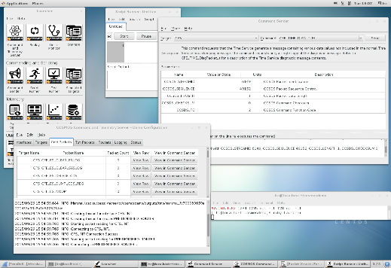
NOS³ Work In Progress
STF-1
Commanding & Telemetry
cFS
Hardware Lib
OS Abstraction Layer (OSAL)
Ground System Software
(ITOS, COSMOS)
Linux
(x86, ARM/Pi)
FreeRTOS
(AVR32)
NOS Engine
Hardware Adapter
i2c / SPI
Flight
Hardware
NOS³ UI & Control
Hardware Models
42
NOS³
Notes:
Diffused arches
(Intermediate)
To reproduce the shape effects on this slide, do the following:
On the Home tab, in the Slides group, click Layout, and then click Blank.
On the Home tab, in the Drawing group, click Shapes, and then under Lines, click Curve (tenth option from the left).
On the slide, click three points to draw a simple curved line, and then double-click to finish drawing.
Select the curved line. On the Home tab, in the Drawing group, click the arrow next to Shape Fill, point to Gradient, and then click More Gradients. In the Format Shape dialog box, click Fill in the left pane, select Gradient fill in the Fill pane, and then do the following:
In the Type list, select Linear.
Click the button next to Direction, and then click Linear Down (first row, second option from the left).
Under Gradient stops, click Add gradient stop or Remove gradient stop until two stops appear in the slider.
Also under Gradient stops, customize the gradient stops that you added as follows:
Select the first stop in the slider, and then do the following:
In the Position box, enter 0%.
Click the button next to Color, and then under Theme Colors click White, Background 1 (first row, first option from the left).
In the Transparency box, enter 50%.
Select the second stop in the slider, and then do the following:
In the Position box, enter 100%.
Click the button next to Color, and then under Theme Colors click White, Background 1 (first row, first option from the left).
In the Transparency box, enter 100%.
On the Home tab, in the Drawing group, click Shape Effects, point to Soft Edges, and then click 5 point.
On the Home tab, in the Drawing group, click the arrow next to Shape Outline, and then click No Outline.
To reproduce the background effects on this slide, do the following:
Right-click the slide background area, and then click Format Background. In the Format Background dialog box, click Fill in the left pane, select Gradient fill in the right pane, and then do the following:
In the Type list, select Radial.
Click the button next to Direction, and then click From Center (third option from the left).
Under Gradient stops, click Add gradient stop or Remove gradient stop until two stops appear in the slider
Also under Gradient stops, customize the gradient stops that you added as follows:
Select the first stop in the slider, and then do the following:
In the Position box, enter 0%.
Click the button next to Color, and then under Theme Colors click White, Background 1 (first row, first option from the left).
Select the second stop in the slider, and then do the following:
In the Position box, enter 100%.
Click the button next to Color, and then under Theme Colors click White, Background 1, Darker 50% (sixth row, first option from the left).
To reproduce the duplicate curved lines on the slide, do the following:
On the Home tab, in the Clipboard group, click the arrow under Copy, and then click Duplicate. Repeat the process for a total of three curved lines.
On the slide, drag the curved lines to position them as needed.
Right-click one of the duplicate curved lines, click Edit Points, and then drag the points on the curve to make a new shape. Repeat the process with the other duplicate curved line.

Slide 25
NOS³ Work in Progress
Notes:
Diffused arches
(Intermediate)
To reproduce the shape effects on this slide, do the following:
On the Home tab, in the Slides group, click Layout, and then click Blank.
On the Home tab, in the Drawing group, click Shapes, and then under Lines, click Curve (tenth option from the left).
On the slide, click three points to draw a simple curved line, and then double-click to finish drawing.
Select the curved line. On the Home tab, in the Drawing group, click the arrow next to Shape Fill, point to Gradient, and then click More Gradients. In the Format Shape dialog box, click Fill in the left pane, select Gradient fill in the Fill pane, and then do the following:
In the Type list, select Linear.
Click the button next to Direction, and then click Linear Down (first row, second option from the left).
Under Gradient stops, click Add gradient stop or Remove gradient stop until two stops appear in the slider.
Also under Gradient stops, customize the gradient stops that you added as follows:
Select the first stop in the slider, and then do the following:
In the Position box, enter 0%.
Click the button next to Color, and then under Theme Colors click White, Background 1 (first row, first option from the left).
In the Transparency box, enter 50%.
Select the second stop in the slider, and then do the following:
In the Position box, enter 100%.
Click the button next to Color, and then under Theme Colors click White, Background 1 (first row, first option from the left).
In the Transparency box, enter 100%.
On the Home tab, in the Drawing group, click Shape Effects, point to Soft Edges, and then click 5 point.
On the Home tab, in the Drawing group, click the arrow next to Shape Outline, and then click No Outline.
To reproduce the background effects on this slide, do the following:
Right-click the slide background area, and then click Format Background. In the Format Background dialog box, click Fill in the left pane, select Gradient fill in the right pane, and then do the following:
In the Type list, select Radial.
Click the button next to Direction, and then click From Center (third option from the left).
Under Gradient stops, click Add gradient stop or Remove gradient stop until two stops appear in the slider
Also under Gradient stops, customize the gradient stops that you added as follows:
Select the first stop in the slider, and then do the following:
In the Position box, enter 0%.
Click the button next to Color, and then under Theme Colors click White, Background 1 (first row, first option from the left).
Select the second stop in the slider, and then do the following:
In the Position box, enter 100%.
Click the button next to Color, and then under Theme Colors click White, Background 1, Darker 50% (sixth row, first option from the left).
To reproduce the duplicate curved lines on the slide, do the following:
On the Home tab, in the Clipboard group, click the arrow under Copy, and then click Duplicate. Repeat the process for a total of three curved lines.
On the slide, drag the curved lines to position them as needed.
Right-click one of the duplicate curved lines, click Edit Points, and then drag the points on the curve to make a new shape. Repeat the process with the other duplicate curved line.

Slide 26
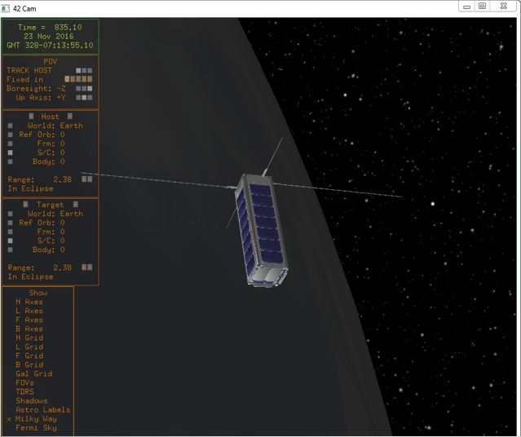
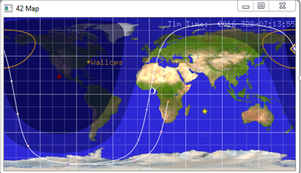
NOS³ Visualization
Notes:
Diffused arches
(Intermediate)
To reproduce the shape effects on this slide, do the following:
On the Home tab, in the Slides group, click Layout, and then click Blank.
On the Home tab, in the Drawing group, click Shapes, and then under Lines, click Curve (tenth option from the left).
On the slide, click three points to draw a simple curved line, and then double-click to finish drawing.
Select the curved line. On the Home tab, in the Drawing group, click the arrow next to Shape Fill, point to Gradient, and then click More Gradients. In the Format Shape dialog box, click Fill in the left pane, select Gradient fill in the Fill pane, and then do the following:
In the Type list, select Linear.
Click the button next to Direction, and then click Linear Down (first row, second option from the left).
Under Gradient stops, click Add gradient stop or Remove gradient stop until two stops appear in the slider.
Also under Gradient stops, customize the gradient stops that you added as follows:
Select the first stop in the slider, and then do the following:
In the Position box, enter 0%.
Click the button next to Color, and then under Theme Colors click White, Background 1 (first row, first option from the left).
In the Transparency box, enter 50%.
Select the second stop in the slider, and then do the following:
In the Position box, enter 100%.
Click the button next to Color, and then under Theme Colors click White, Background 1 (first row, first option from the left).
In the Transparency box, enter 100%.
On the Home tab, in the Drawing group, click Shape Effects, point to Soft Edges, and then click 5 point.
On the Home tab, in the Drawing group, click the arrow next to Shape Outline, and then click No Outline.
To reproduce the background effects on this slide, do the following:
Right-click the slide background area, and then click Format Background. In the Format Background dialog box, click Fill in the left pane, select Gradient fill in the right pane, and then do the following:
In the Type list, select Radial.
Click the button next to Direction, and then click From Center (third option from the left).
Under Gradient stops, click Add gradient stop or Remove gradient stop until two stops appear in the slider
Also under Gradient stops, customize the gradient stops that you added as follows:
Select the first stop in the slider, and then do the following:
In the Position box, enter 0%.
Click the button next to Color, and then under Theme Colors click White, Background 1 (first row, first option from the left).
Select the second stop in the slider, and then do the following:
In the Position box, enter 100%.
Click the button next to Color, and then under Theme Colors click White, Background 1, Darker 50% (sixth row, first option from the left).
To reproduce the duplicate curved lines on the slide, do the following:
On the Home tab, in the Clipboard group, click the arrow under Copy, and then click Duplicate. Repeat the process for a total of three curved lines.
On the slide, drag the curved lines to position them as needed.
Right-click one of the duplicate curved lines, click Edit Points, and then drag the points on the curve to make a new shape. Repeat the process with the other duplicate curved line.

Slide 27
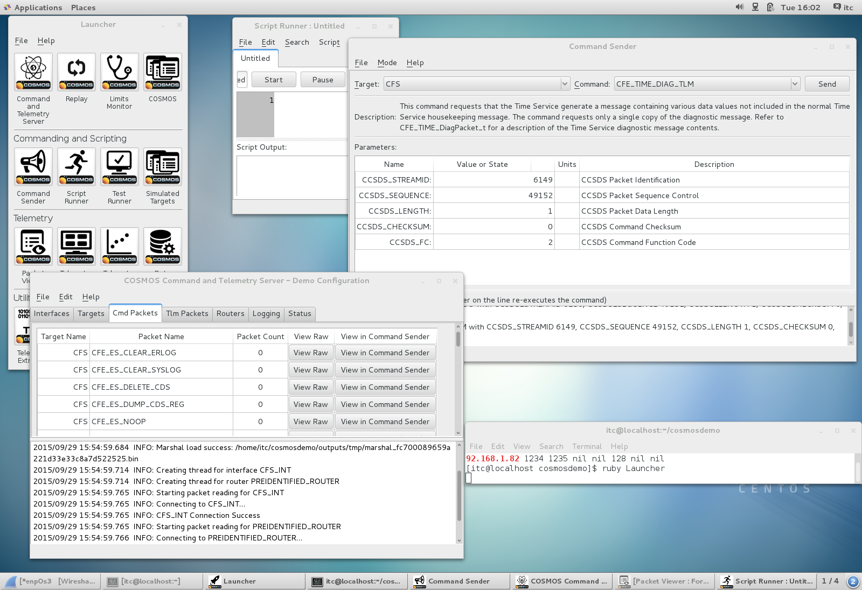
NOS³ Ground System Integration
Notes:
Diffused arches
(Intermediate)
To reproduce the shape effects on this slide, do the following:
On the Home tab, in the Slides group, click Layout, and then click Blank.
On the Home tab, in the Drawing group, click Shapes, and then under Lines, click Curve (tenth option from the left).
On the slide, click three points to draw a simple curved line, and then double-click to finish drawing.
Select the curved line. On the Home tab, in the Drawing group, click the arrow next to Shape Fill, point to Gradient, and then click More Gradients. In the Format Shape dialog box, click Fill in the left pane, select Gradient fill in the Fill pane, and then do the following:
In the Type list, select Linear.
Click the button next to Direction, and then click Linear Down (first row, second option from the left).
Under Gradient stops, click Add gradient stop or Remove gradient stop until two stops appear in the slider.
Also under Gradient stops, customize the gradient stops that you added as follows:
Select the first stop in the slider, and then do the following:
In the Position box, enter 0%.
Click the button next to Color, and then under Theme Colors click White, Background 1 (first row, first option from the left).
In the Transparency box, enter 50%.
Select the second stop in the slider, and then do the following:
In the Position box, enter 100%.
Click the button next to Color, and then under Theme Colors click White, Background 1 (first row, first option from the left).
In the Transparency box, enter 100%.
On the Home tab, in the Drawing group, click Shape Effects, point to Soft Edges, and then click 5 point.
On the Home tab, in the Drawing group, click the arrow next to Shape Outline, and then click No Outline.
To reproduce the background effects on this slide, do the following:
Right-click the slide background area, and then click Format Background. In the Format Background dialog box, click Fill in the left pane, select Gradient fill in the right pane, and then do the following:
In the Type list, select Radial.
Click the button next to Direction, and then click From Center (third option from the left).
Under Gradient stops, click Add gradient stop or Remove gradient stop until two stops appear in the slider
Also under Gradient stops, customize the gradient stops that you added as follows:
Select the first stop in the slider, and then do the following:
In the Position box, enter 0%.
Click the button next to Color, and then under Theme Colors click White, Background 1 (first row, first option from the left).
Select the second stop in the slider, and then do the following:
In the Position box, enter 100%.
Click the button next to Color, and then under Theme Colors click White, Background 1, Darker 50% (sixth row, first option from the left).
To reproduce the duplicate curved lines on the slide, do the following:
On the Home tab, in the Clipboard group, click the arrow under Copy, and then click Duplicate. Repeat the process for a total of three curved lines.
On the slide, drag the curved lines to position them as needed.
Right-click one of the duplicate curved lines, click Edit Points, and then drag the points on the curve to make a new shape. Repeat the process with the other duplicate curved line.

